Slide 1
IE 340/440
PROCESS IMPROVEMENT
THROUGH PLANNED EXPERIMENTATION
Fundamentals of Hypothesis Testing: One-Sample Tests
Dr. Xueping Li
University of Tennessee

Slide 2

Chapter Topics
Hypothesis Testing Methodology
Z Test for the Mean ( Known)
p-Value Approach to Hypothesis Testing
Connection to Confidence Interval Estimation
One-Tail Tests
t Test for the Mean ( Unknown)
Z Test for the Proportion
Potential Hypothesis-Testing Pitfalls and Ethical Issues

Slide 3

What is a Hypothesis?
A Hypothesis is a
Claim (Assumption)
about the Population
Parameter
  Examples of parameters
  are population mean
  or proportion
  The parameter must
  be identified before
  analysis
I claim the mean GPA of this class is 3.5!
© 1984-1994 T/Maker Co.

Slide 4
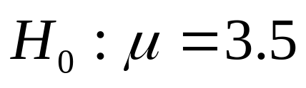
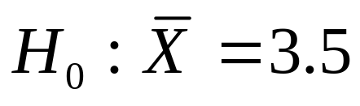
The Null Hypothesis, H₀
States the Assumption (Numerical) to be Tested
  E.g., The mean GPA is 3.5
Null Hypothesis is Always about a Population Parameter ( ), Not about a Sample Statistic ( )
Is the Hypothesis a Researcher Tries to Reject

Slide 5

The Null Hypothesis, H₀
(continued)
Begin with the Assumption that the Null Hypothesis is True
  Similar to the notion of innocent until
  proven guilty
Refer to the Status Quo
Always Contains the “=” Sign
The Null Hypothesis May or May Not be Rejected

Slide 6
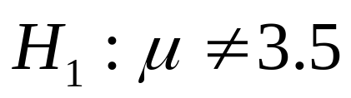
The Alternative Hypothesis, H₁
Is the Opposite of the Null Hypothesis
  E.g., The mean GPA is NOT 3.5 ( )
Challenges the Status Quo
Never Contains the “=” Sign
The Alternative Hypothesis May or May Not Be Accepted (i.e., The Null Hypothesis May or May Not Be Rejected)
Is Generally the Hypothesis that the Researcher Claims

Slide 7
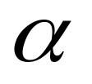
Error in Making Decisions
Type I Error
  Reject a true null hypothesis
    When the null hypothesis is rejected, we can say that “We have shown the null hypothesis to be false (with some ‘slight’ probability, i.e.
    , of making a wrong decision)
  Has serious consequences
  Probability of Type I Error is
    Called level of significance
    Set by researcher

Slide 8

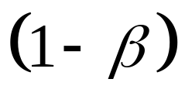
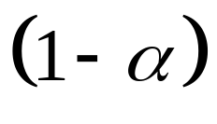
Error in Making Decisions
(continued)
Type II Error
  Fail to reject a false null hypothesis
  Probability of Type II Error is
  The power of the test is
Probability of Not Making Type I Error
  Called the Confidence Coefficient

Slide 9

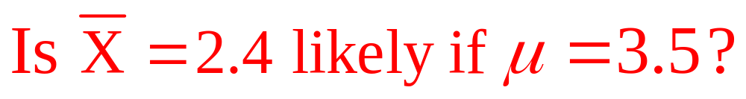
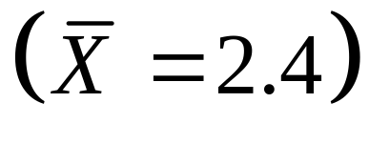
Hypothesis Testing Process
Assume the
population
mean GPA is 3.5
( )
Identify the Population
Take a Sample
No, not likely!
REJECT
Null Hypothesis

Slide 10
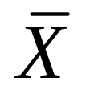

Reason for Rejecting H₀
Sampling Distribution of
It is unlikely that we would get a sample mean of this value ...
... Therefore, we reject the null hypothesis that = 3.5.
... if in fact this were
the population mean.
μ
2.4
= 3.5
If H₀ is true

Slide 11

Level of Significance,
Defines Unlikely Values of Sample Statistic if Null Hypothesis is True
  Called rejection region of the sampling distribution
Designated by , (level of significance)
  Typical values are .01, .05, .10
Selected by the Researcher at the Beginning
Controls the Probability of Committing a Type I Error
Provides the Critical Value(s) of the Test

Slide 12
Level of Significance and the Rejection Region
α
H₀: μ ≥ 3.5 H₁: μ < 3.5
Critical Value(s)
Rejection Regions
0
α
H₀: μ ≤ 3.5 H₁: μ > 3.5
0
α/2
H₀: μ = 3.5 H₁: μ ≠ 3.5
0

Slide 13
Result Probabilities
H₀: Innocent
Jury Trial
Hypothesis
Test
The Truth
The Truth
Verdict
Innocent
Guilty
Decision
H
True
H
False
0
0
Do Not
Type II
Innocent
Correct
Error
Reject
1 -
α
β
)
Error (
H
0
Type I
Error
Reject
Power
Guilty
Correct
Error
H
(1 -
)
0
β
(
)
α

Slide 14

Type I & II Errors Have an Inverse Relationship
Reduce probability of one error and the other one goes up holding everything else unchanged.
β
α

Slide 15

Factors Affecting Type II Error
True Value of Population Parameter
  increases when the difference between the hypothesized parameter and its true value decrease
Significance Level
  increases when decreases
Population Standard Deviation
  increases when increases
Sample Size
  increases when n decreases
n

Slide 16
How to Choose between Type I and Type II Errors
Choice Depends on the Cost of the Errors
Choose Smaller Type I Error When the Cost of Rejecting the Maintained Hypothesis is High
  A criminal trial: convicting an innocent person
  The Exxon Valdez: causing an oil tanker to sink
Choose Larger Type I Error When You Have an Interest in Changing the Status Quo
  A decision in a startup company about a new piece of software
  A decision about unequal pay for a covered group

Slide 17
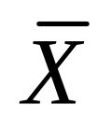
Critical Values Approach to Testing
Convert Sample Statistic (e.g., ) to Test Statistic (e.g., Z, t or F –statistic)
Obtain Critical Value(s) for a Specified
from a Table or Computer
  If the test statistic falls in the critical region, reject H₀
  Otherwise, do not reject H₀

Slide 18



p-Value Approach to Testing
Convert Sample Statistic (e.g., ) to Test Statistic (e.g., Z, t or F –statistic)
Obtain the p-value from a table or computer
  p-value: probability of obtaining a test statistic as extreme or more extreme ( or ) than the observed sample value given H₀ is true
  Called observed level of significance
  Smallest value of that an H₀ can be rejected
Compare the p-value with
  If p-value , do not reject H₀
  If p-value , reject H₀

Slide 19
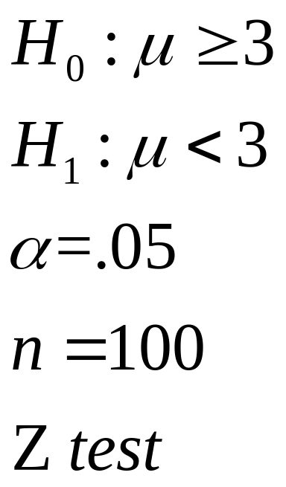
General Steps in Hypothesis Testing
E.g., Test the Assumption that the True Mean # of TV Sets in U.S. Homes is at Least 3 ( Known)
State the H₀
State the H₁
Choose
Choose n
Choose Test

Slide 20
General Steps in Hypothesis Testing
(continued)
Set up critical value(s)
Collect data
Compute test statistic and p-value
Make statistical decision
Express conclusion
Reject H₀
100 households surveyed
Computed test stat =-2,
p-value = .0228
Reject null hypothesis
The true mean # TV set is less than 3
α
Z
-1.645

Slide 21


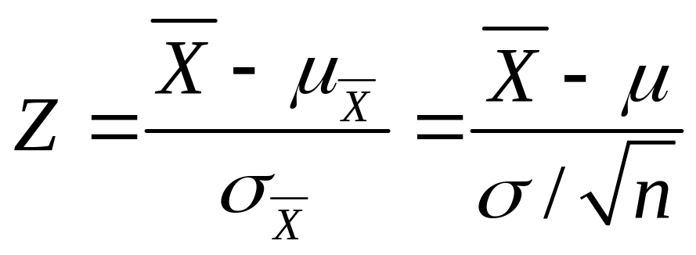
One-Tail Z Test for Mean
( Known)
Assumptions
  Population is normally distributed
  If not normal, requires large samples
  Null hypothesis has or sign only
  is known
Z Test Statistic

Slide 22
Rejection Region
H₀: μ ≥ μ₀ H₁: μ < μ₀
H₀: μ ≤ μ₀ H₁: μ > μ₀
Reject H₀
Reject H₀
0
Z
0
Z
Z must be significantly below 0 to reject H₀
Small values of Z don’t contradict H₀ ; don’t reject H₀ !

Slide 23

Example: One-Tail Test
Does an average box of cereal contain more than 368 grams of cereal? A random sample of 25 boxes showed = 372.5. The company has specified σ to be 15 grams. Test at the α = 0.05 level.
368 gm.
H₀: μ ≤ 368 H₁: μ > 368

Slide 24
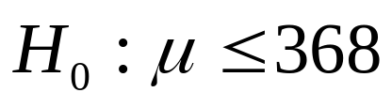

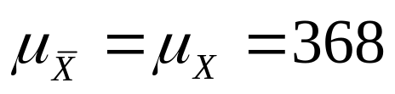
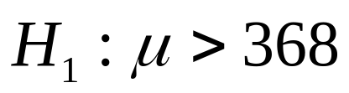
Reject and Do Not Reject Regions
Reject
.05
Do Not Reject
372.5
0
Z
1.645
1.50

Slide 25
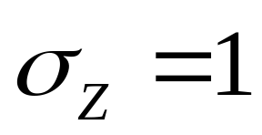
Finding Critical Value: One-Tail
Standardized Cumulative Normal Distribution Table (Portion)
What is Z given α = 0.05?
.05
Z
.04
.06
.95
1.6
.9495
.9505
.9515
α = .05
1.7
.9591
.9599
.9608
0
1.645
Z
1.8
.9671
.9678
.9686
Critical Value = 1.645
.9738
.9750
1.9
.9744

Slide 26
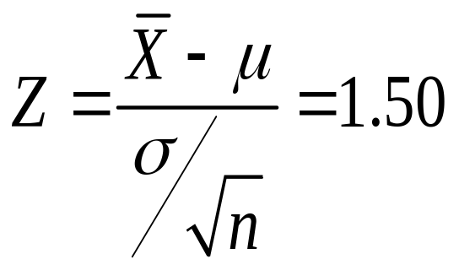
Example Solution: One-Tail Test
H₀: μ ≤ 368 H₁: μ > 368
Test Statistic:
Decision:
Conclusion:
α = 0.05
n = 25
Critical Value: 1.645
Reject
.05
Do Not Reject at α = .05.
0
Insufficient Evidence that True Mean is More Than 368.
1.645
Z
1.50

Slide 27
p -Value Solution
p-Value is P(Z ≥ 1.50) = 0.0668
Use the alternative hypothesis to find the direction of the rejection region.
p-Value =.0668
1.0000
- .9332
.0668
0
1.50
Z
From Z Table: Lookup 1.50 to Obtain .9332
Z Value of Sample Statistic

Slide 28
p -Value Solution
(continued)
(p-Value = 0.0668) ≥ (α = 0.05)
Do Not Reject.
p Value = 0.0668
Reject
α = 0.05
0
Z
1.645
1.50
Test Statistic 1.50 is in the Do Not Reject Region

Slide 29

One-Tail Z Test for Mean
( Known) in PHStat
PHStat | One-Sample Tests | Z Test for the Mean, Sigma Known …
Example in Excel Spreadsheet

Slide 30
Example: Two-Tail Test
Does an average box of cereal contain 368 grams of cereal? A random sample of 25 boxes showed = 372.5. The company has specified σ to be 15 grams and the distribution to be normal. Test at the α = 0.05 level.
368 gm.
H₀: μ = 368 H₁: μ ≠ 368

Slide 31
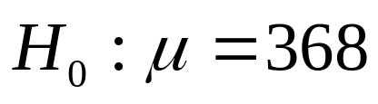
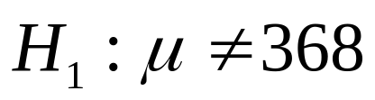
Reject and Do Not Reject Regions
Reject
Reject
.025
.025
372.5
0
Z
-1.96
1.96
1.50

Slide 32
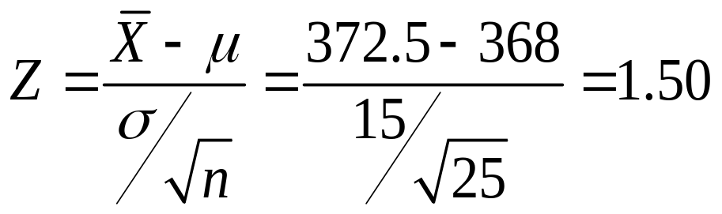
Example Solution: Two-Tail Test
H₀: μ = 368 H₁: μ ≠ 368
Test Statistic:
Decision:
Conclusion:
α = 0.05
n = 25
Critical Value: ±1.96
Reject
Do Not Reject at α = .05.
.025
.025
Insufficient Evidence that True Mean is Not 368.
-1.96
0
1.96
Z
1.50

Slide 33
p-Value Solution
(p-Value = 0.1336) ≥ (α = 0.05)
Do Not Reject.
p-Value = 2 x 0.0668
Reject
Reject
α = 0.05
0
Z
1.50
1.96
Test Statistic 1.50 is in the Do Not Reject Region

Slide 34

Two-Tail Z Test for Mean
( Known) in PHStat
PHStat | One-Sample Tests | Z Test for the Mean, Sigma Known …
Example in Excel Spreadsheet

Slide 35
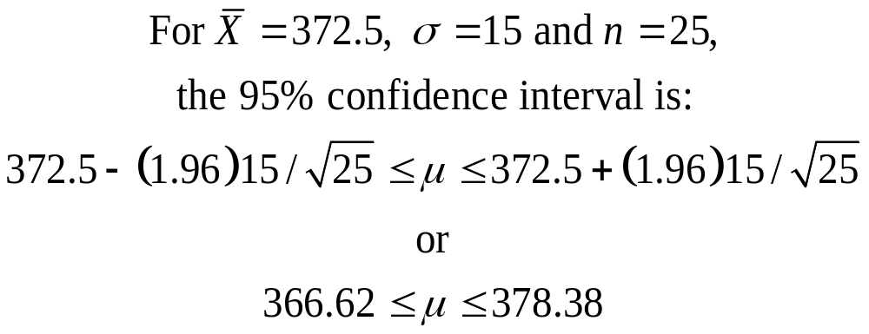
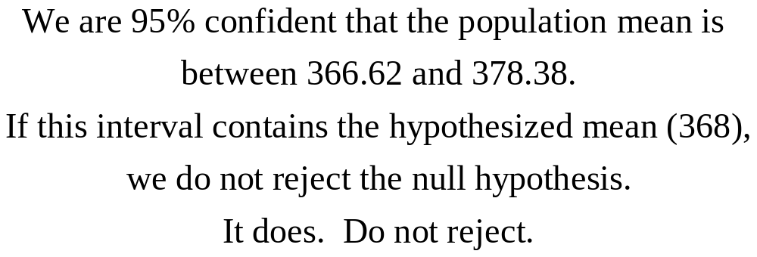
Connection to Confidence Intervals

Slide 36
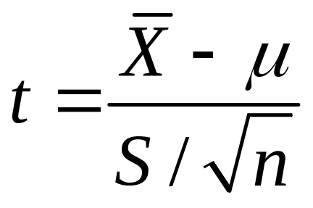
t Test: Unknown
Assumption
  Population is normally distributed
  If not normal, requires a large sample
  is unknown
t Test Statistic with n-1 Degrees of Freedom

Slide 37
Example: One-Tail t Test
Does an average box of cereal contain more than 368 grams of cereal? A random sample of 36 boxes showed X = 372.5, and s = 15. Test at the α = 0.01 level.
368 gm.
H₀: μ ≤ 368 H₁: μ > 368
σ is not given

Slide 38
Reject and Do Not Reject Regions
Reject
.01
Do Not Reject
372.5
t₃₅
0
2.4377
1.80

Slide 39
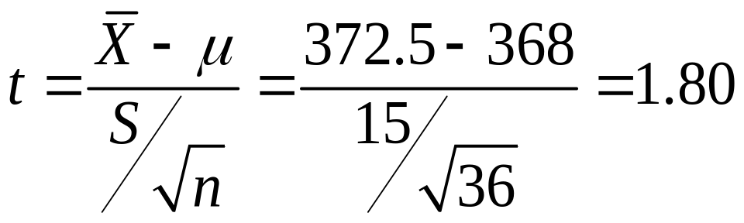
Example Solution: One-Tail
H₀: μ ≤ 368 H₁: μ > 368
Test Statistic:
Decision:
Conclusion:
α = 0.01
n = 36, df = 35
Critical Value: 2.4377
Reject
Do Not Reject at a = .01.
.01
Insufficient Evidence that True Mean is More Than 368.
0
2.4377
t₃₅
1.80

Slide 40
p -Value Solution
(p-Value is between .025 and .05) ≥ (α = 0.01)
Do Not Reject.
p-Value = [.025, .05]
Reject
α = 0.01
0
t₃₅
1.80
2.4377
Test Statistic 1.80 is in the Do Not Reject Region

Slide 41

t Test: Unknown in PHStat
PHStat | One-Sample Tests | t Test for the Mean, Sigma Known …
Example in Excel Spreadsheet

Slide 42
Proportion
Involves Categorical Variables
Two Possible Outcomes
  “Success” (possesses a certain characteristic) and
  “Failure” (does not possess a certain characteristic)
Fraction or Proportion of Population in the “Success” Category is Denoted by p

Slide 43
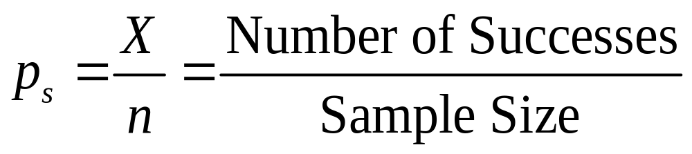
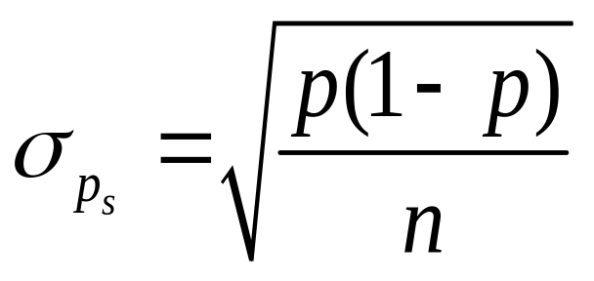
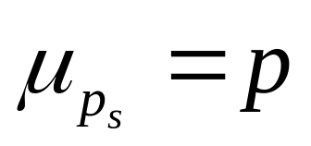
Proportion
(continued)
Sample Proportion in the Success Category is Denoted by p_{S}
When Both np and n(1-p) are at Least 5, p_{S} Can Be Approximated by a Normal Distribution with Mean and Standard Deviation

Slide 44

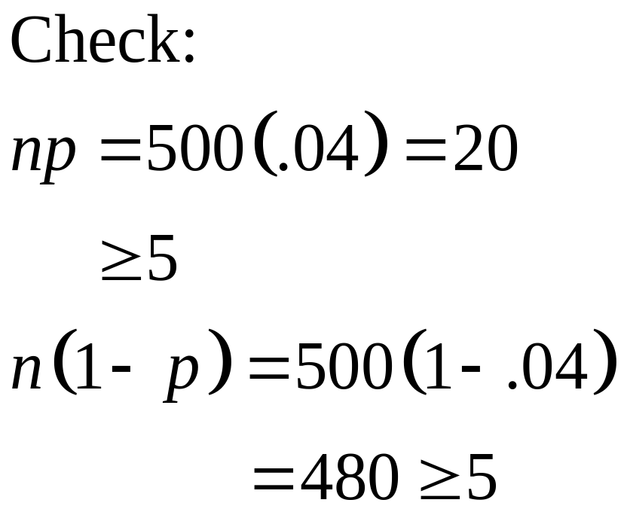
Example: Z Test for Proportion
A marketing company claims that a survey will have a 4% response rate. To test this claim, a random sample of 500 were surveyed with 25 responses. Test at the α = .05 significance level.

Slide 45
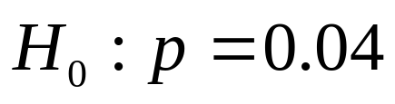

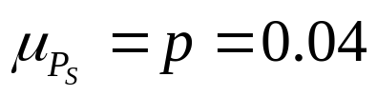
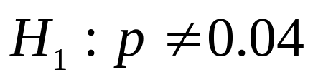
Reject and Do Not Reject Regions
Reject
Reject
.025
.025
0.05
0
Z
-1.96
1.96
1.1411

Slide 46
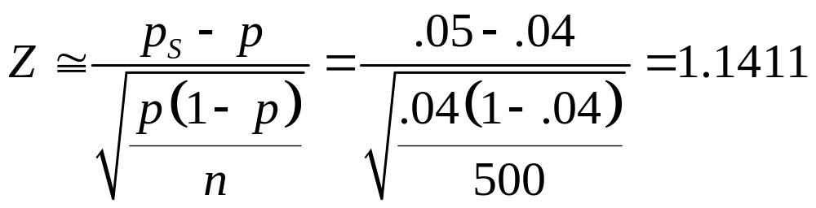
Z Test for Proportion: Solution
H₀: p = .04 H₁: p ≠ .04
Test Statistic:
α = .05
n = 500
Critical Values: ± 1.96
Decision:
Reject
Reject
Do not reject at α = .05.
.025
.025
Conclusion:
0.05
We do not have sufficient evidence to reject the company’s claim of 4% response rate.
0.04
Z
-1.96
0
1.96
1.1411

Slide 47
p -Value Solution
(p-Value = 0.2538) ≥ (α = 0.05)
Do Not Reject.
p-Value = 2 x .1269
Reject
Reject
α = 0.05
0
Z
1.1411
1.96
Test Statistic 1.1411 is in the Do Not Reject Region

Slide 48

Z Test for Proportion in PHStat
PHStat | One-Sample Tests | Z Test for the Proportion …
Example in Excel Spreadsheet

Slide 49
Potential Pitfalls and
Ethical Issues
Data Collection Method is Not Randomized to Reduce Selection Biases
Treatment of Human Subjects are Manipulated Without Informed Consent
Data Snooping is Used to Choose between One-Tail and Two-Tail Tests, and to Determine the Level of Significance

Slide 50
Potential Pitfalls and
Ethical Issues
(continued)
Data Cleansing is Practiced to Hide Observations that do not Support a Stated Hypothesis
Fail to Report Pertinent Findings

Slide 51
Chapter Summary
Addressed Hypothesis Testing Methodology
Performed Z Test for the Mean ( Known)
Discussed p –Value Approach to Hypothesis Testing
Made Connection to Confidence Interval Estimation

Slide 52
Chapter Summary
(continued)
Performed One-Tail and Two-Tail Tests
Performed t Test for the Mean ( Unknown)
Performed Z Test for the Proportion
Discussed Potential Pitfalls and Ethical Issues

